Slide 1

Sales Forecasting Assignment (R1)
For Job Role: Data Scientist
Submitted by: Dileep Sathyan Date: 06-August-2022

Slide 2
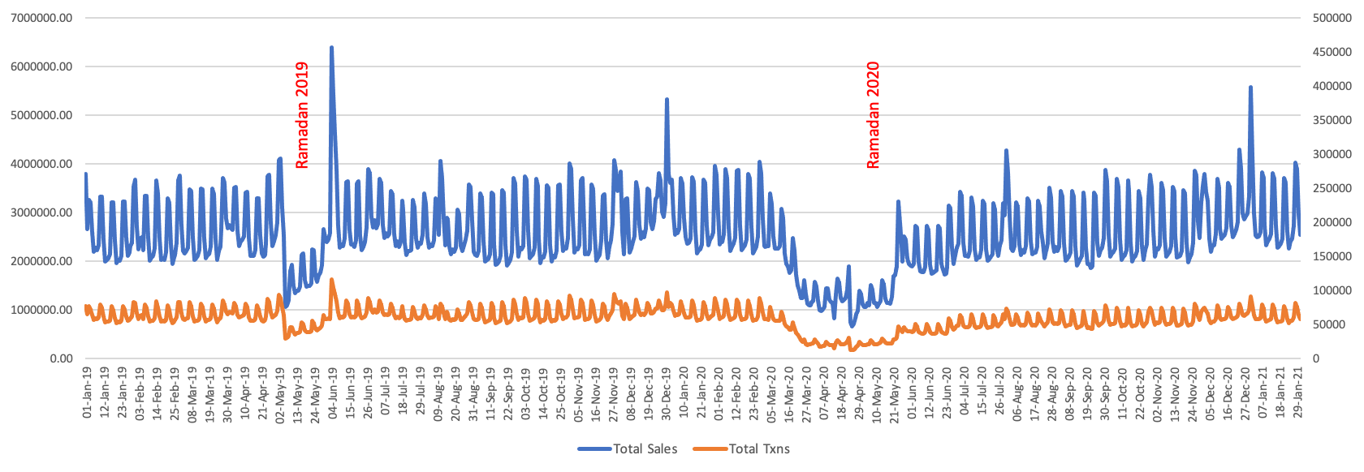
Identifying Seasonality:
Given data points clearly follow 2 patterns:
A ‘weekly trend’ show increased Sales and Transactions during the weekend.
An ‘yearly pattern’ which coincides with the Ramadan season in the UAE (highlighted in Yellow).
The drop of sales during the Ramadan is vivid even after considering the Lockdown period of 2020 due to Covid.

Slide 3
Forecasting Methodology:
Data Discrepancies & Rectifications:
StoreID 10058: Dataset mentions the Open Date of this store as ‘9/1/2019’. However, the Sales and Transactions are available for this store from 01st Jan 2019 onwards. Since neither can we consider the date as 01st September nor 09th Jan 2019, I must assume that the store has been open since 2018.
StoreIDs 10165 & 10113: These stores stopped receiving orders on 16-Mar-2020 and 24-Mar-2020 respectively. Hence, these are intentionally omitted from forecasting for the year 2021.
Limitations In Getting Precise Forecasts:
The Sales and Transaction counts of each Store seem to differ (which is sensible).
The considerable difference in the Sales among the units, is assumed to be due to Geographical differences of the stores.
Since the Geographical data are not provided, all the new stores are assumed to have a uniform Sales and Transactions of an ideal store, which in this case is matched with StoreID 10155, because of the below 2 reasons.
10155 has been continuously operational even when the other stores did have no sales (may be closed) at all.
10155 has been making stable revenue which is expected from any new stores being opened.

Slide 4
Forecasting Methodology:
Handling Missing Data:
Missing data points due to vacation or lockdown are handled by using the Average of the Sales (and Transactions) data of the same weekdays of the previous 2 weeks. (For example, the missing Sales data of 3rd Wednesday in a month has been filled in by taking the average of the 1st & 2nd Wednesday’s Sales figures of that month).
Forecasting for Feb - Dec 2021:
Sales and Transaction values for all the stores (including new stores) are forecasted considering the ‘Seasonality as 354 days’ (which is the difference between the 2 consequent Ramadan start dates for the time period in the given dataset.
Closed stores and the ones which have been non-operational for a considerable time period have been omitted while doing the forecasting.

Slide 5
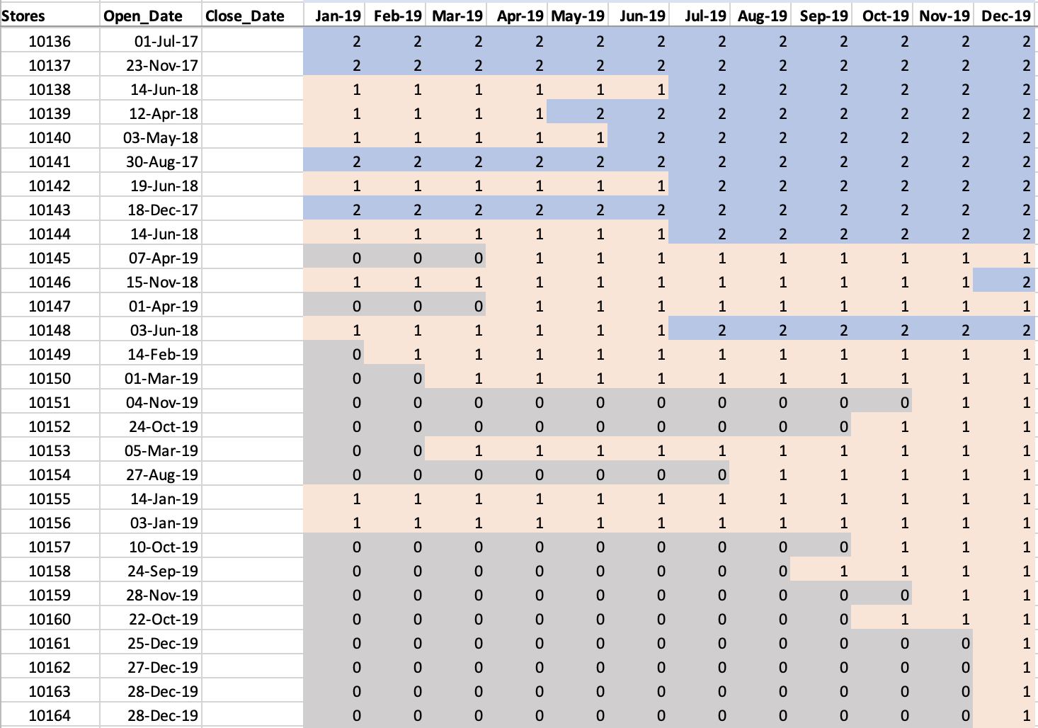
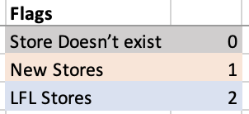
Forecasting Methodology:
Categorizing Stores for FY-2019:
Considering all given criteria for 2019, the stores have been categorized into New Stores, LFL Stores and the ones that have not opened in that month.

Slide 6
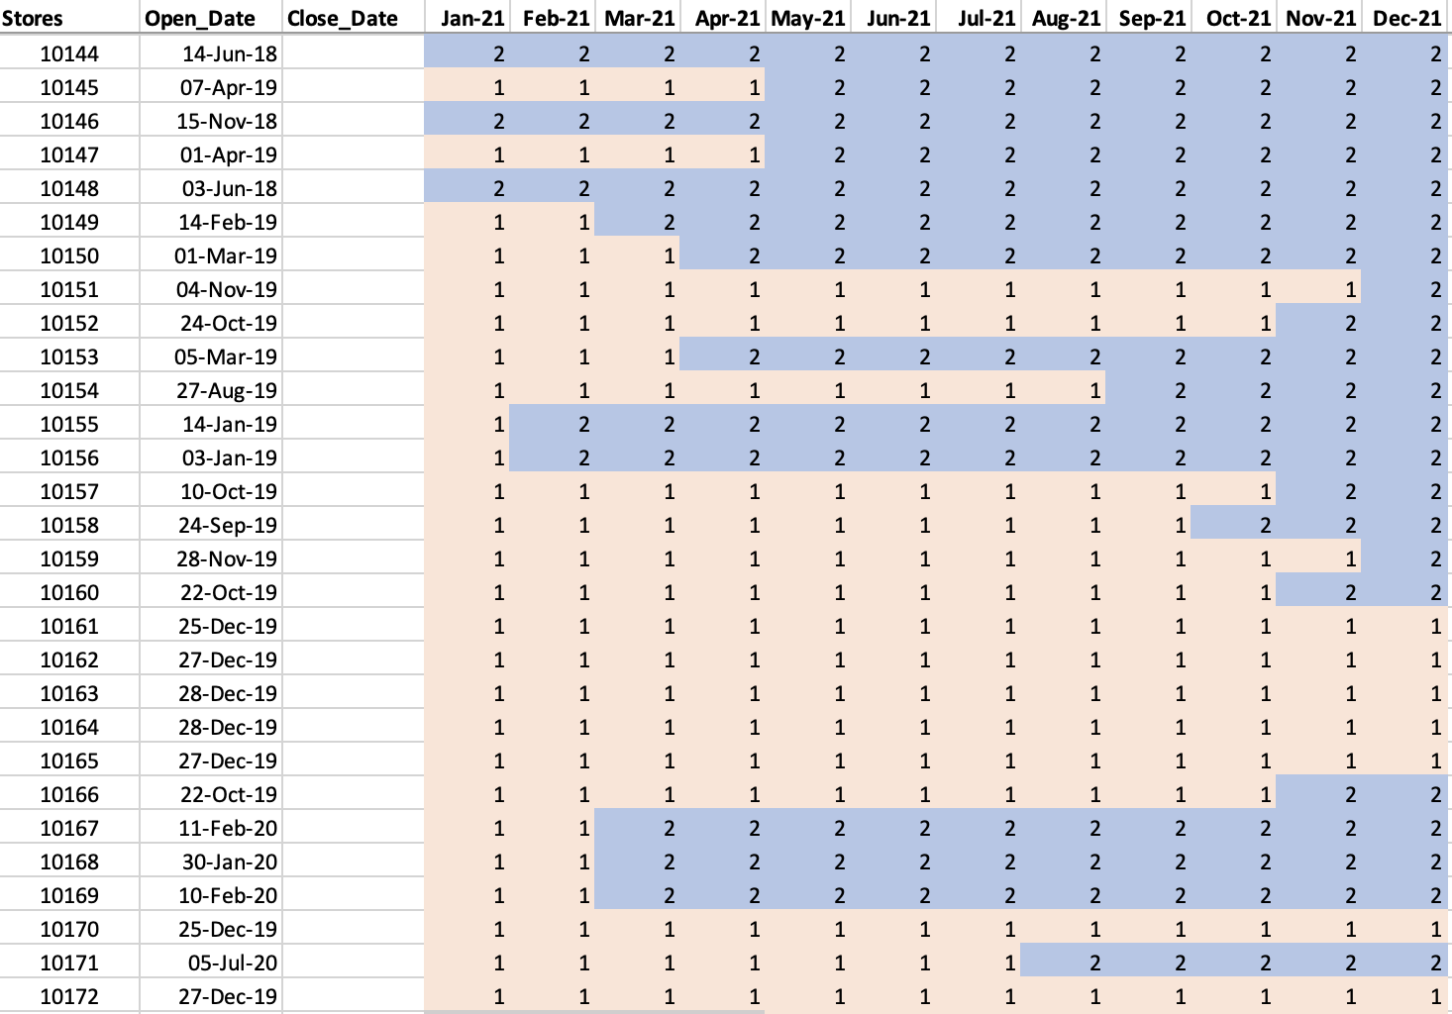
Forecasting Methodology:
Categorizing Stores for FY-2021:
Considering all given criteria for 2021, the stores have been categorized into New Stores, LFL Stores and the ones that have not opened in that month.

Slide 7
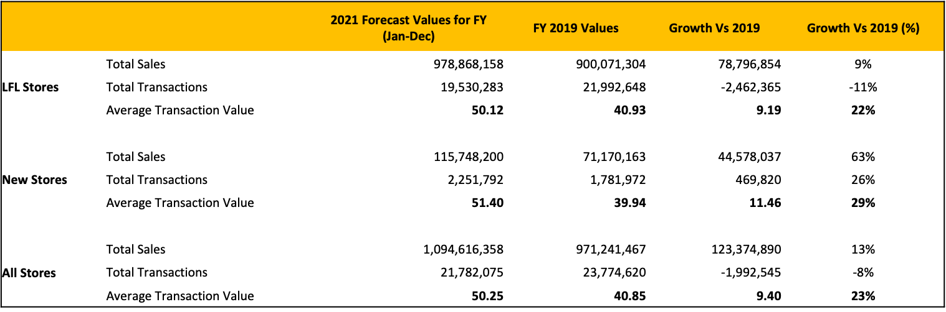
Summary:
From the below summary in comparison to the year 2019, we can conclude the below.
LFL Stores are expected to have a 9% growth in Sales compared to 2019, although having lesser Transactions. This reversal can be due to either the increased Average Transactional Value and/or increase in the Selling prices of the products.
With the addition of more New Stores, 2021 is expected to have outstanding growth in Sales (63%) and Transactions (26%).
Overall, in the FY 2021, the total revenue generated by All Stores are expected to increase by 13% from 2019, despite of having a decrease in the count of orders. The Average Transaction Amount is expected to be AED 50.25 per order which is 23% higher than that of 2019.

Slide 8
Thank you!

